Slide 1


Bank Loan Case Study
SAHIL SAVALIYA

Slide 2


Project Description
The project is about finding out patterns that indicate if a customer will have difficulty paying their installments. This information can be used to make decisions such as denying the loan, reducing the amount of loan, or lending at a higher interest rate to risky applicants. We analyze this data on the following points:
Identify Missing Data and Deal with it Appropriately
Identify Outliers in the Dataset
Analyze Data Imbalance
Perform Univariate, Segmented Univariate, and Bivariate Analysis
Identify Top Correlations for Different Scenarios

Slide 3
Missing Data
Task A: Identify the missing data in the dataset and decide on an appropriate method to deal with it using Excel built-in functions and features.
Using COUNT, IF and ISBLANK function to get number of null values for each column.
Then we will calculate percentage of null values for each column.
Using TRANSPOSE function we will convert rows to columns.
We will drop the columns which has more than or equal to 50% null values.
We will drop irrelevant columns for doing our analysis
Formulas:-
no_of_null_values: =COUNT(IF(ISBLANK(application_data!AW2:AW50000),application_data!$A:$A))
Transpose: =TRANSPOSE(A1:DS3)

Slide 4
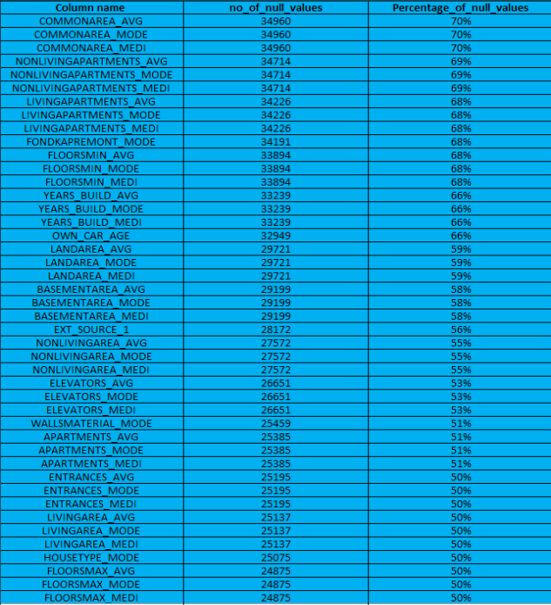
Missing Data
These are the columns which has null values more
than or equal to 50%.These columns need to be dropped.

Slide 5
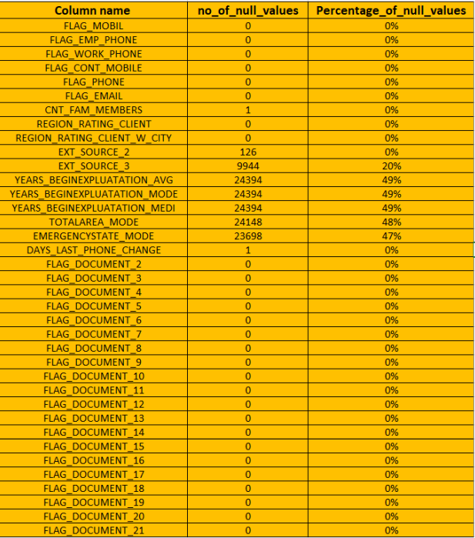
Missing Data
These are the columns which have irrelevant data for analysis.
These columns need to be dropped.

Slide 6
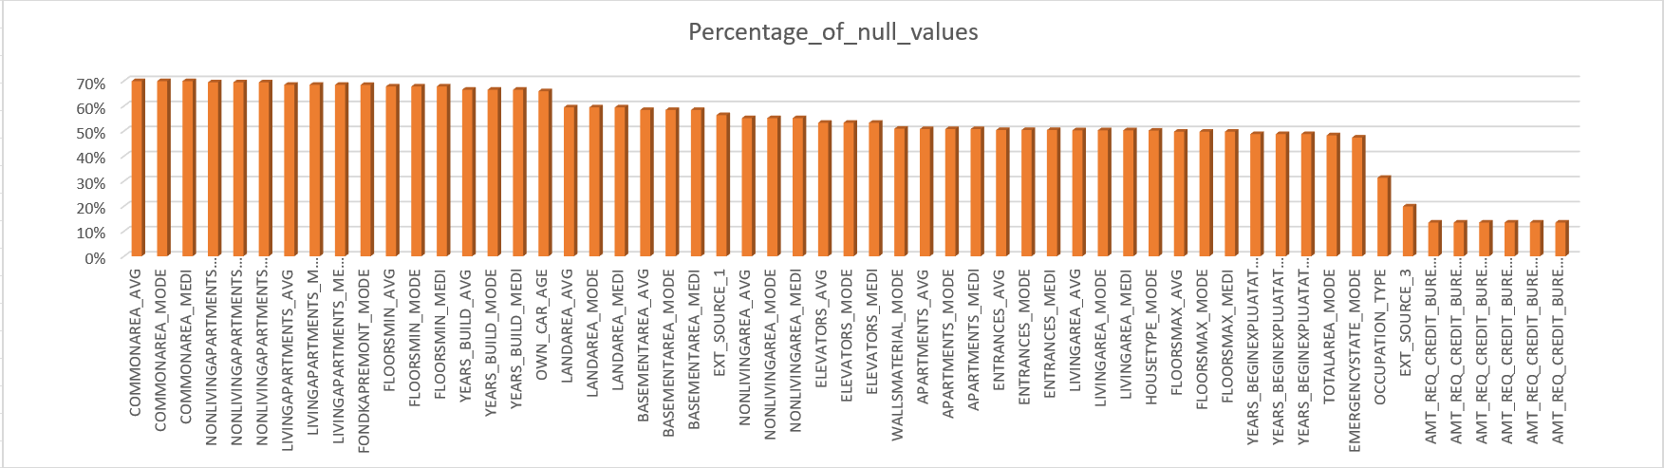
Missing Data

Slide 7
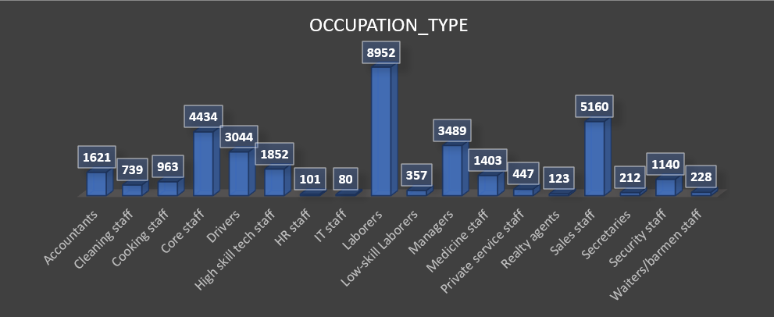
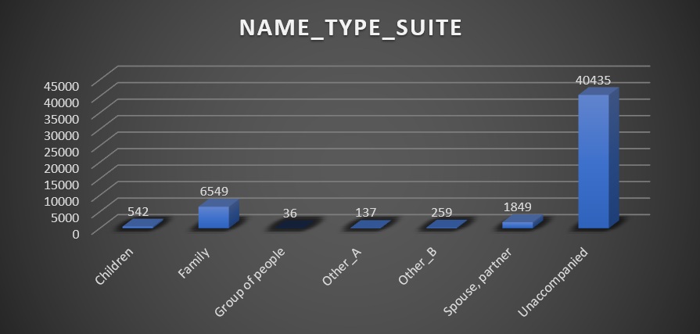
Missing Data
Mode Imputations:-
1. OCCUPATION_TYPE
2. NAME_TYPE_SUITE
Most Occurring Variable is Laborers.
We will replace blanks with 8952.
Most Occurring Variable is Unaccompanied.

Slide 8
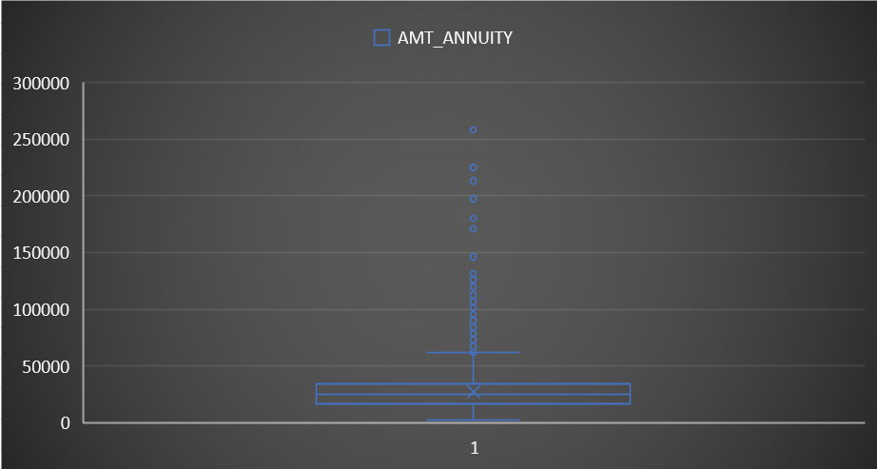
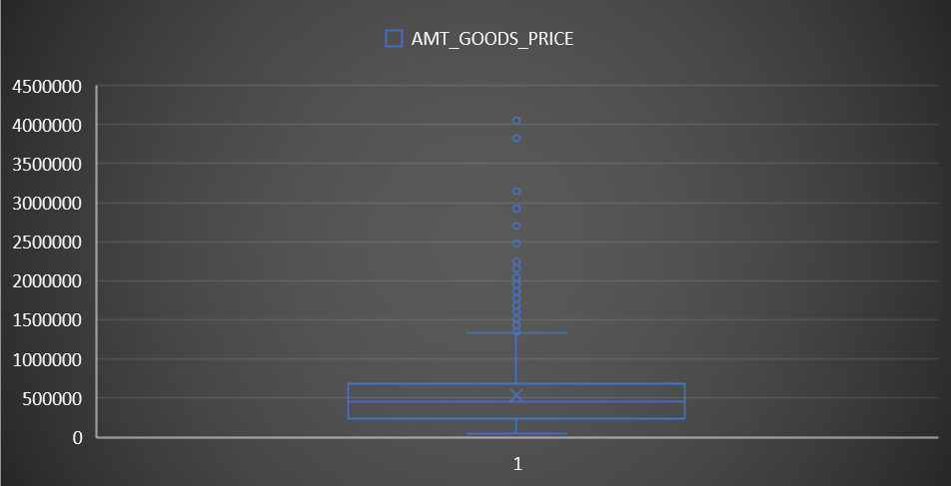
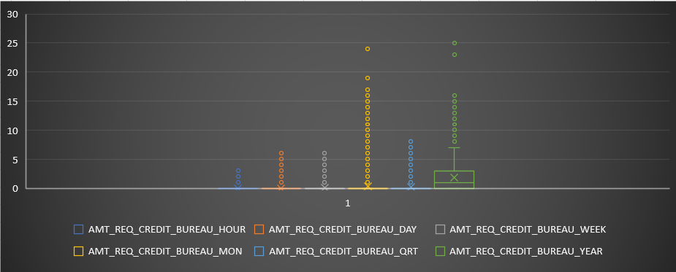
Missing Data
Median Imputations:-
1. AMT_ANNUITY
2. AMT_GOODS_PRICE
AMT_REQ_CREDIT_BUREAU_HOUR
AMT_REQ_CREDIT_BUREAU_DAY
AMT_REQ_CREDIT_BUREAU_WEEK
AMT_REQ_CREDIT_BUREAU_MON
AMT_REQ_CREDIT_BUREAU_QRT
AMT_REQ_CREDIT_BUREAU_YEAR

Slide 9
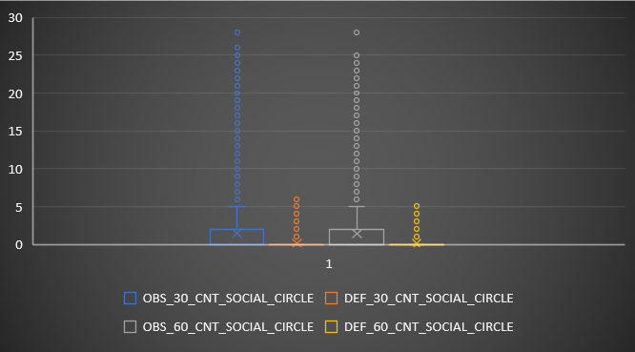
Missing Data
1.DEF_30_CNT_SOCIAL_CIRCLE
2.OBS_30_CNT_SOCIAL_CIRCLE
3.DEF_60_CNT_SOCIAL_CIRCLE
4.OBS_60_CNT_SOCIAL_CIRCLE

Slide 10
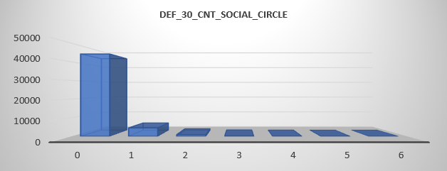
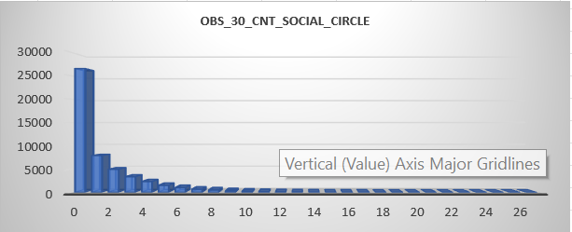
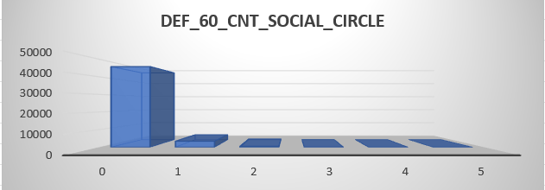
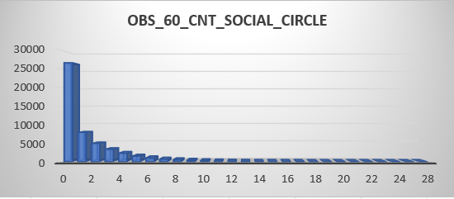
Missing Data

Slide 11
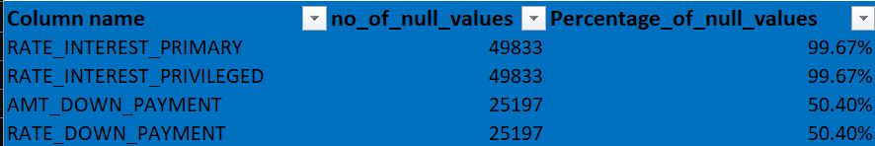
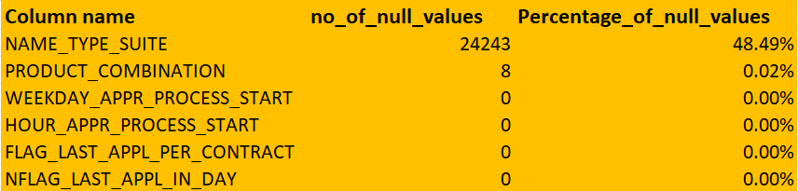
Missing Data
These are the columns which has null values more than or equal to 50%.
These columns need to be dropped.
These are the columns which have
irrelevant data for analysis.
These columns need to be dropped.

Slide 12
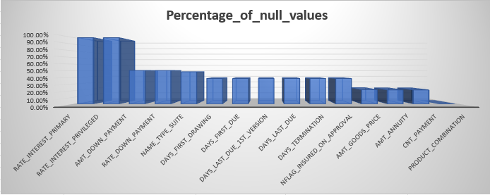
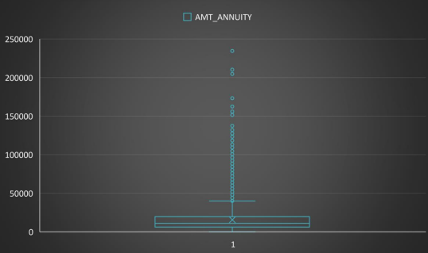
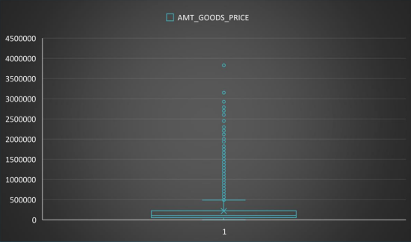
Missing Data
Previous_application datasets
Median Imputations:
1. AMT_ANNUITY
2. AMT_GOODS_PRICE

Slide 13
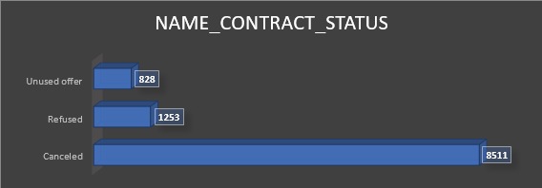
Missing Data
Previous_application datasets
Custom Imputations:-
CNT_PAYMENT
Most of Blank cells of cnt_payments have contract_status as canceled, refused, unused offer.
So it makes more sense replacing them with 0 rather than Mean or Median.

Slide 14
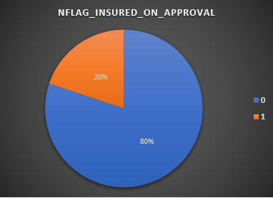
Missing Data
Previous_application datasets
Mode Imputations:-
1. NFLAG_INSURED_ON_APPROVAL

Slide 15
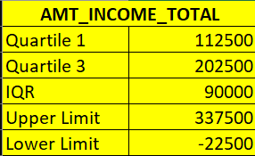
Outliers
Task B:Detect and identify outliers in the dataset using Excel statistical functions and features, focusing on numerical variables.
First we will select numerical columns like AMT_INCOME_TOTAL and AMT_CREDIT.
Calculate Quartile 1, Quartile 3, IQR, Upper Limit and Lower Limit.
We will use Box Plot to highlight the outliers.
Formulas:-
Quartile 1 : =QUARTILE(A:A,1 )
Quartile 3 : =QUARTILE(A:A,3)
IQR = Quartile 3 - Quartile 1
Upper Limit = Quartile 3 + 1.5*IQR
Lower Limit = Quartile 1 – 1.5IQR

Slide 16
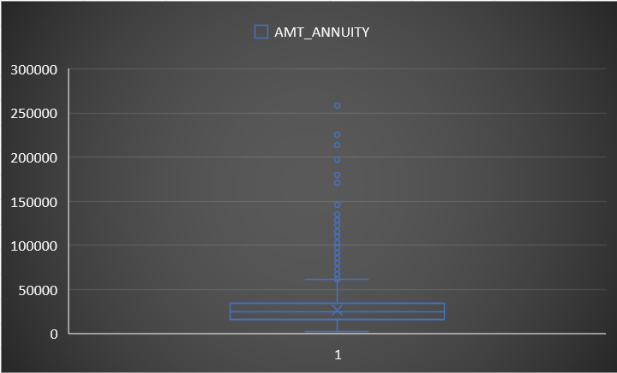
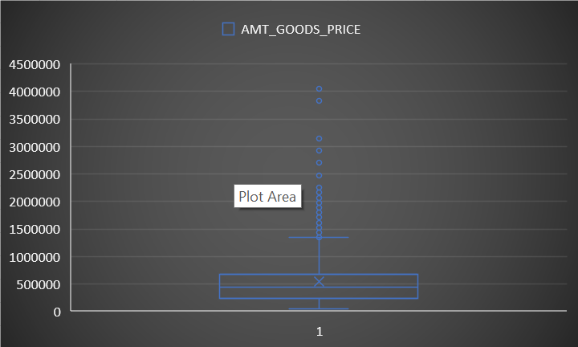
Outliers
In the chart we can see there are few outliers in columns like AMT_ANNUITY and AMT_GOODS_PRICE.

Slide 17
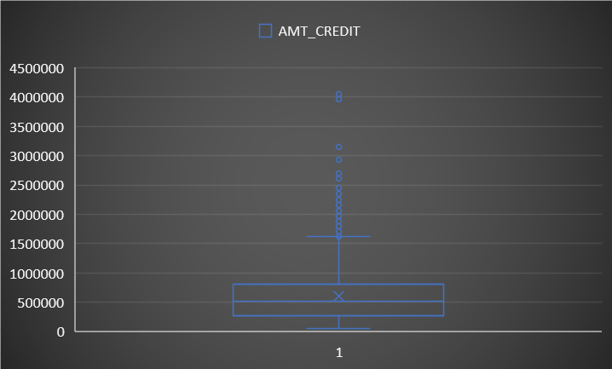
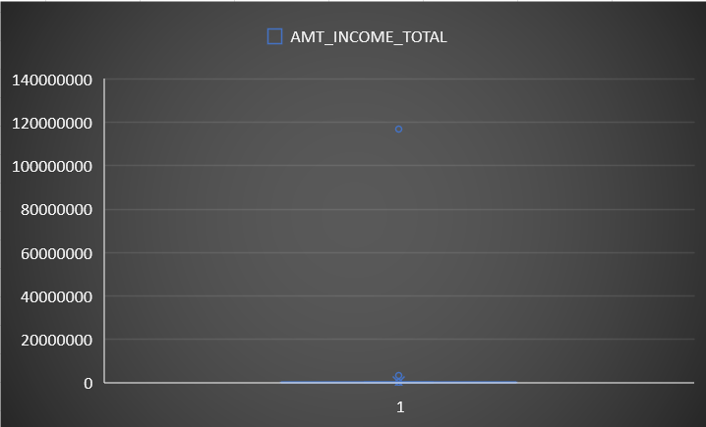
Outliers
There are few outliers in columns like AMT_CREDIT and AMT_INCOME_TOTAL where amount is higher than normal.
In AMT_INCOME_TOTAL one of extreme outlier is 117000000 but we will not remove because income of person varies.
We will not remove outlier from AMT_CREDIT too.

Slide 18
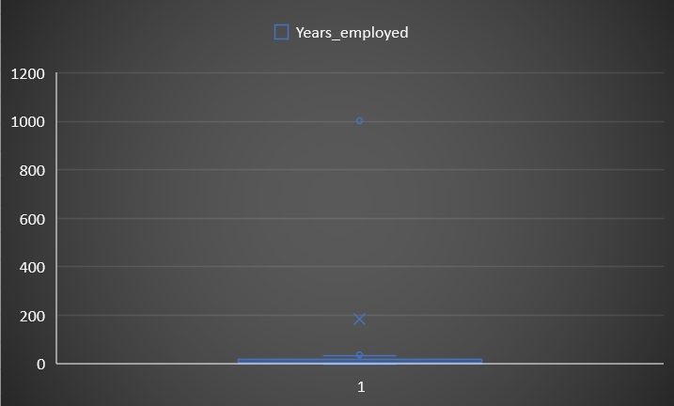
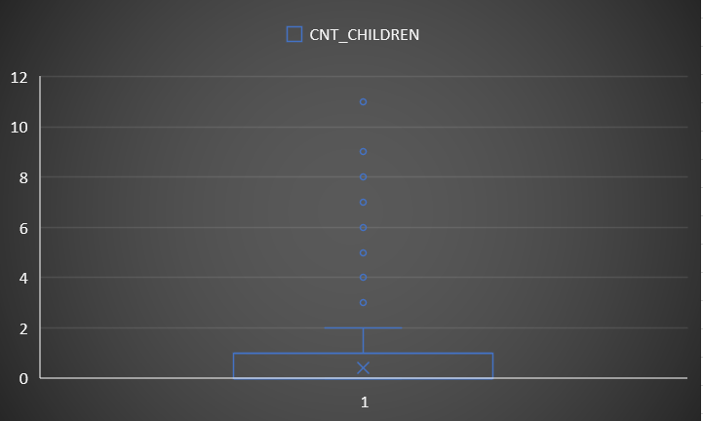
Outliers
In Column Years_employed we can see people being employed for 1001 yrs which is not possible. Column CNT_CHILDREN
shows people are having 11 children which is impossible in today’s age

Slide 19
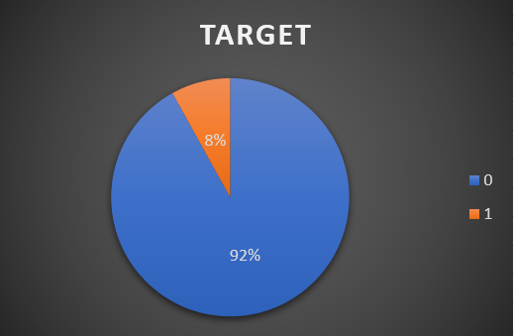
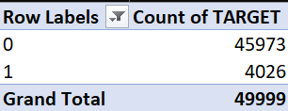
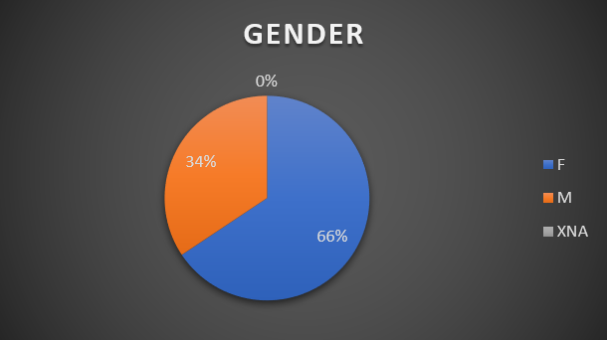
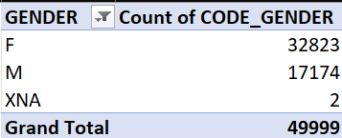
Data Imbalance
Task C: Determine if there is data imbalance in the loan application dataset and calculate the ratio of data imbalance
using Excel functions.
TARGET COLUMN
Almost 92% clients are loan re-payers. 8% client are Defaulters.
CODE_GENDER COLUMN
Almost 66% client are Female and 34% clients are Male.

Slide 20
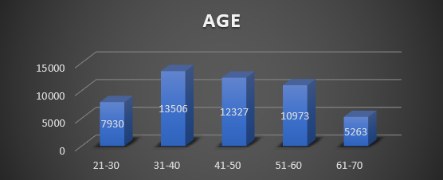
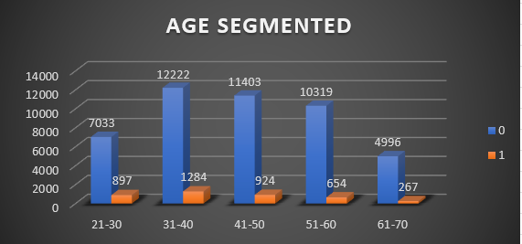
Univariate/Segmented Univariate Analysis
Task D: Perform univariate analysis to understand the distribution of individual variables,
segmented univariate and bivariate analysis.
Majority of the Clients are in the age group 31-40.
we can see as age increases , chances of defaulter decreases.

Slide 21
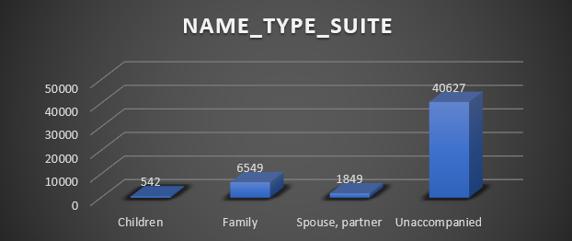
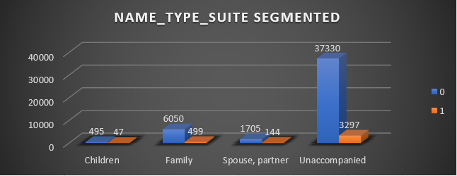
Univariate/Segmented Univariate Analysis
Majority of the Clients are Unaccompanied followed by Family.

Slide 22
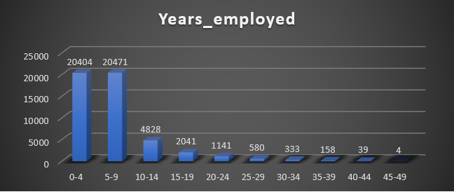
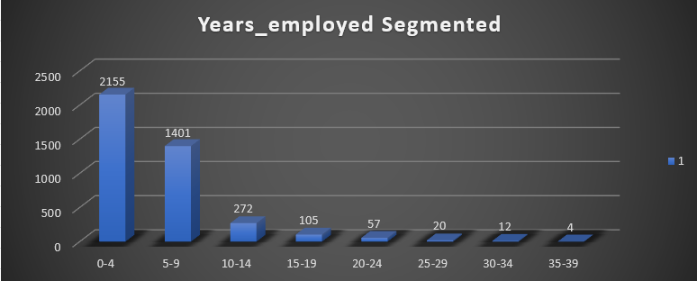
Univariate/Segmented Univariate Analysis
Majority of the Clients are having 0-9 years of experience.
we can see as experience increases , chances of
defaulting decreases.

Slide 23
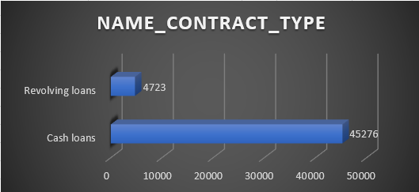
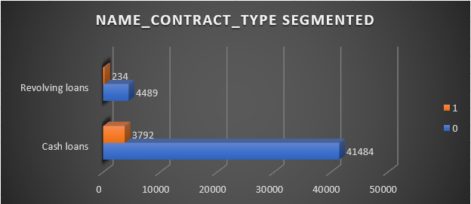
Univariate/Segmented Univariate Analysis
Majority of the Clients are taking Cash loans

Slide 24
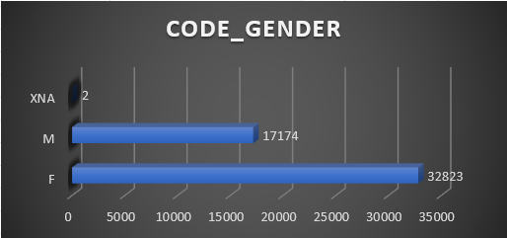
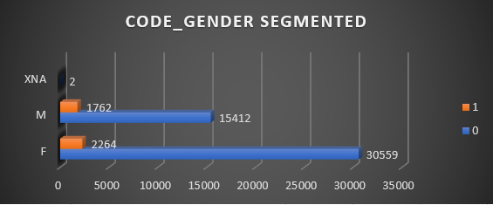
Univariate/Segmented Univariate Analysis
Male are less defaulters compared to Female.

Slide 25
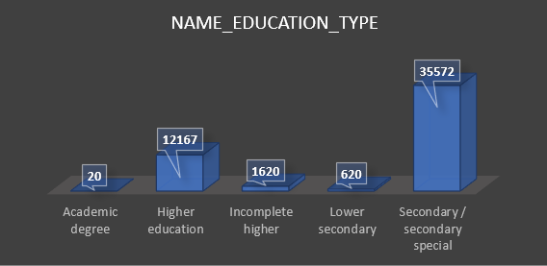
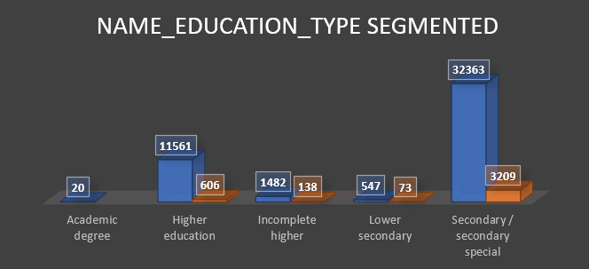
Univariate/Segmented Univariate Analysis
The numbers of loans taken by Clients with Secondary
special Education is the highest and Academic degree
is the lowest
Least default: Academic degree
Highest default: Secondary special

Slide 26
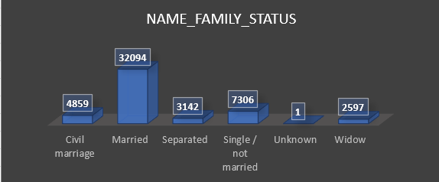
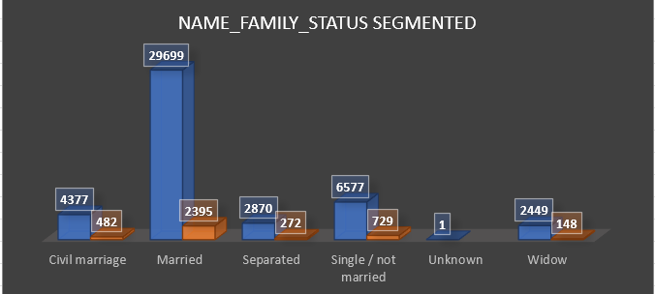
Univariate/Segmented Univariate Analysis
The number of loans taken by Married clients are the highest
and clients who are widows are the least if we ignore unknown.
Least Defaulter: Widow
Highest Defaulter : Married

Slide 27
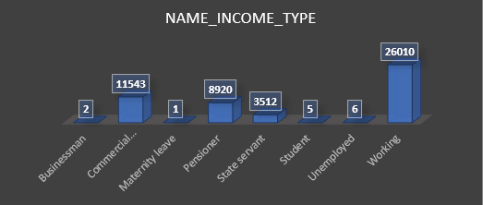
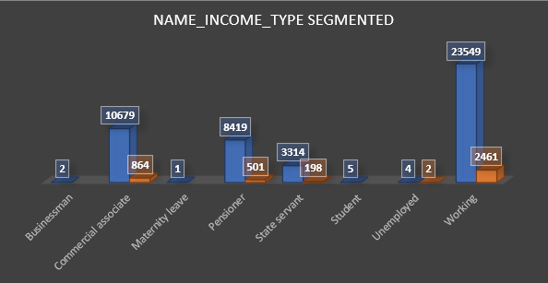
Univariate/Segmented Univariate Analysis
Bank target those groups whose income type is working.
Least default: Client who is Businessman or student or at Maternity leave.
Highest default: Client who is working

Slide 28
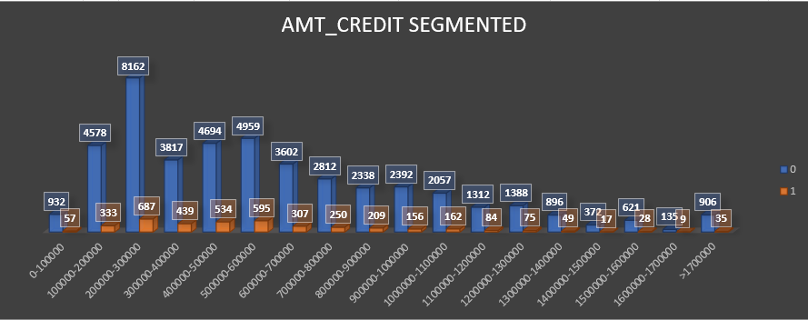
Univariate/Segmented Univariate Analysis
Majority of the Clients took the loan between 2L – 3L.

Slide 29
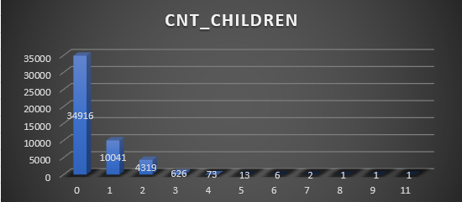
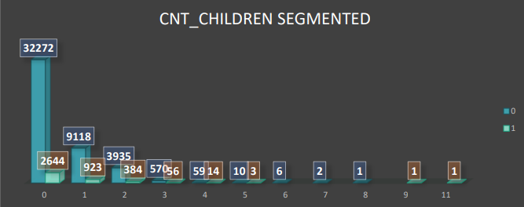
Univariate/Segmented Univariate Analysis
The highest number of loans are taken by Clients who does
not have a child
As number of children increases, number of client who took loan decreases

Slide 30

Univariate/Segmented Univariate Analysis
Clients who are working in business Entity type of Organization took the highest number of loans.

Slide 31

Univariate/Segmented Univariate Analysis
Previous_application datasets
More number of Clients were approved for loans previously.

Slide 32

Bivariate Analysis
Age group 40-49 took the highest amount of loan but age group 50-59 are defaulter with highest amount of loan.

Slide 33

Bivariate Analysis
As we see Businessman took the highest amount of loan and did the payment on time. Clients who are unemployed have highest amount of loan which they didn’t repay on time

Slide 34

Correlation
Task E: Segment the dataset based on different scenarios (e.g., clients with payment difficulties and all other cases) and identify the top correlations for each segmented data using Excel functions.
Top Correlation Coefficients for Payment difficulties are:-

Slide 35

Correlation

Slide 36

Correlation
Top Correlation Coefficients for Re-payers are:

Slide 37

Correlation
Top Correlation Coefficients for Re-payers are:-

Slide 38
Conclusions
• Most of the clients are loan re-payers.
• The Bank generally lends more loan to Female as compared to Male but Male are less defaulters compared to Female.
• As age and experience increases , chances of defaulter decreases.
• Most of the clients are taking cash loans.
• Educated clients tend to less defaulter compared to clients with lower education such as secondary special education so Bank should prefer clients with having such education status.
• As number of children increases, number of client who take loan decreases.
• The Bank should be more cautious when lending money to clients who are unemployed because they are the most defaulters with highest amount of credit.
• As age increases amount taken by Clients are considerably high but with higher age defaulter percentage is lower. These are least risky and more profitable for Bank.

